Slide 1


Open Call for
Open Source
Collaboration
rich-iannone
rich@posit.co

Slide 2
PAST
Why did I get involved in open source development? Five thoughts.
About ten years ago, I had these general thoughts about moving into open-source development work:

Slide 3
PAST
Why did I get involved in open source development? Five thoughts.
About ten years ago, I had these general thoughts about moving into open-source development work:
1. I can probably create software that will help me be better at my job.

Slide 4
PAST
Why did I get involved in open source development? Five thoughts.
About ten years ago, I had these general thoughts about moving into open-source development work:
1. I can probably create software that will help me be better at my job.
2. Always felt like learning a programming language, why not now?

Slide 5
PAST
Why did I get involved in open source development? Five thoughts.
About ten years ago, I had these general thoughts about moving into open-source development work:
1. I can probably create software that will help me be better at my job.
2. Always felt like learning a programming language, why not now?
3. It is impressive how much great software you could use for free.

Slide 6
PAST
Why did I get involved in open source development? Five thoughts.
About ten years ago, I had these general thoughts about moving into open-source development work:
1. I can probably create software that will help me be better at my job.
2. Always felt like learning a programming language, why not now?
3. It is impressive how much great software you could use for free.
4. I’ll be able to work on my own project(s) and interact with interesting people.

Slide 7
PAST
Why did I get involved in open source development? Five thoughts.
About ten years ago, I had these general thoughts about moving into open-source development work:
1. I can probably create software that will help me be better at my job.
2. Always felt like learning a programming language, why not now?
3. It is impressive how much great software you could use for free.
4. I’ll be able to work on my own project(s) and interact with interesting people.
5. If I develop a lot of skill in this, it might expand my career prospects.

Slide 8
PAST
How did I get involved in open source development?
Here are the highlights of what I did to break into open source (OS) work.

Slide 9
PAST
How did I get involved in open source development?
Here are the highlights of what I did to break into open source (OS) work.
— I learned R (someone suggested it at work), and learned it on my own

Slide 10
PAST
How did I get involved in open source development?
Here are the highlights of what I did to break into open source (OS) work.
— I learned R (someone suggested it at work), and learned it on my own
— wrote lots of scripts to better create inputs for atmospheric modeling

Slide 11
PAST
How did I get involved in open source development?
Here are the highlights of what I did to break into open source (OS) work.
— I learned R (someone suggested it at work), and learned it on my own
— wrote lots of scripts to better create inputs for atmospheric modeling
— started writing packages (for work) and hosting the work on GitHub (GH)

Slide 12
PAST
How did I get involved in open source development?
Here are the highlights of what I did to break into open source (OS) work.
— I learned R (someone suggested it at work), and learned it on my own
— wrote lots of scripts to better create inputs for atmospheric modeling
— started writing packages (for work) and hosting the work on GitHub (GH)
— got really good at my role because of this; OS work became more general

Slide 13
PAST
How did I get involved in open source development?
Here are the highlights of what I did to break into open source (OS) work.
— I learned R (someone suggested it at work), and learned it on my own
— wrote lots of scripts to better create inputs for atmospheric modeling
— started writing packages (for work) and hosting the work on GitHub (GH)
— got really good at my role because of this; OS work became more general
— I eventually learned more about software engineering, applied those skills

Slide 14
PAST
How did I get involved in open source development?
Here are the highlights of what I did to break into open source (OS) work.
— I learned R (someone suggested it at work), and learned it on my own
— wrote lots of scripts to better create inputs for atmospheric modeling
— started writing packages (for work) and hosting the work on GitHub (GH)
— got really good at my role because of this; OS work became more general
— I eventually learned more about software engineering, applied those skills
— was interacting with hundreds of individuals, mainly on GH and social media

Slide 15
PAST
How did I get involved in open source development?
Here are the highlights of what I did to break into open source (OS) work.
— I learned R (someone suggested it at work), and learned it on my own
— wrote lots of scripts to better create inputs for atmospheric modeling
— started writing packages (for work) and hosting the work on GitHub (GH)
— got really good at my role because of this; OS work became more general
— I eventually learned more about software engineering, applied those skills
— was interacting with hundreds of individuals, mainly on GH and social media
— worked as an machine learning engineer and later as a data scientist

Slide 16
PAST
How did I get involved in open source development?
Here are the highlights of what I did to break into open source (OS) work.
— I learned R (someone suggested it at work), and learned it on my own
— wrote lots of scripts to better create inputs for atmospheric modeling
— started writing packages (for work) and hosting the work on GitHub (GH)
— got really good at my role because of this; OS work became more general
— I eventually learned more about software engineering, applied those skills
— was interacting with hundreds of individuals, mainly on GH and social media
— worked as an machine learning engineer and later as a data scientist
— got a role at RStudio (now Posit) on account of my experience

Slide 17
PAST
What I got out of all that.
WHAT I GAINED:
Satisfying Work
Employable Skills

Slide 18
PAST
What I got out of all that.
WHAT I GAINED:
Satisfying Work
Employable Skills
— making useful things
— move at your own pace

Slide 19
PAST
What I got out of all that.
WHAT I GAINED:
Satisfying Work
Employable Skills
— making useful things
— programming skills useful at work
— move at your own pace
— skills associated with large projects

Slide 20
PAST
What I got out of all that.
WHAT I GAINED:
Satisfying Work
Employable Skills
— making useful things
— programming skills useful at work
— move at your own pace
— skills associated with large projects
Friends Along the Way
— in OS work you can interact with dozens of people, in positive ways
— opportunities to meet people at conferences, meetings; work with them

Slide 21

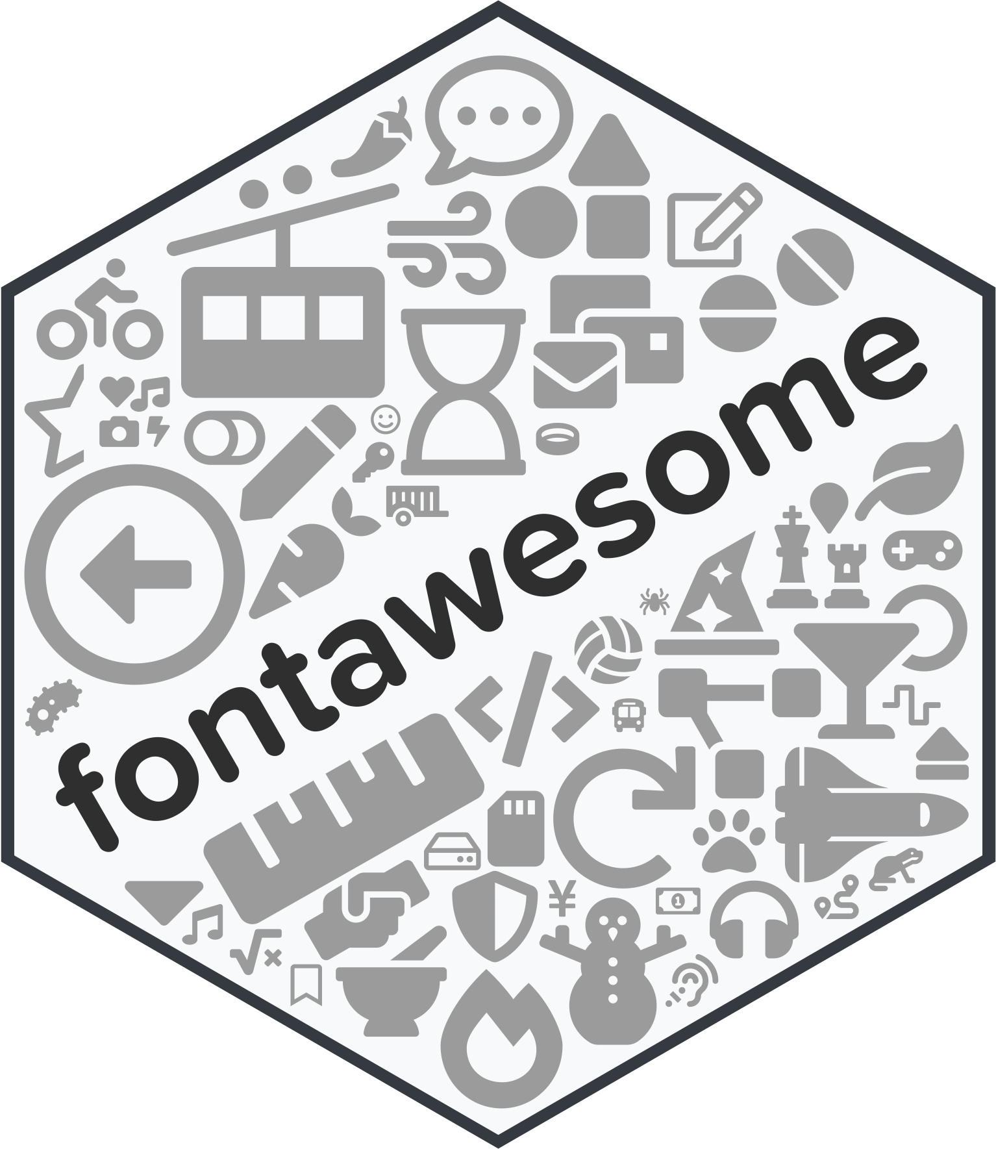

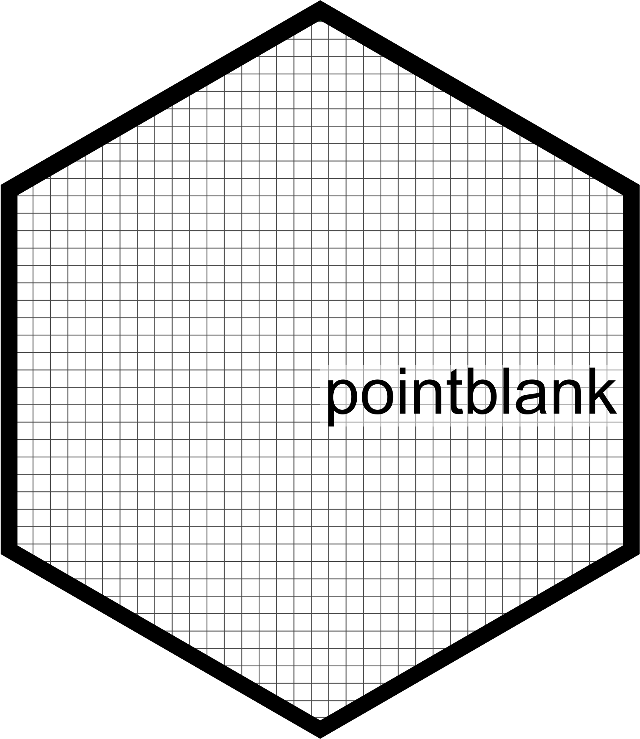

PAST
POSIT
Projects at Posit.
Here are some of the projects I work on at Posit:
blastula
fontawesome
gt
pointblank
bigD
HTML emails through R and Posit Connect
Easily insert icons in reports and Shiny apps
Create tables for reports and other applications
Ensure data correctness, make data docs
Advanced formatting of dates and times

Slide 22
PAST
POSIT
Projects at Posit.
Here are some of the projects I work on at Posit:
blastula
fontawesome
gt
pointblank
bigD
HTML emails through R and Posit Connect
Easily insert icons in reports and Shiny apps
Create tables for reports and other applications
Ensure data correctness, make data docs
Advanced formatting of dates and times

Slide 23
PAST
POSIT
Projects at Posit.
Here are some of the projects I work on at Posit:
blastula
fontawesome
gt
pointblank
bigD
HTML emails through R and Posit Connect
Easily insert icons in reports and Shiny apps
Create tables for reports and other applications
Ensure data correctness, make data docs
Advanced formatting of dates and times

Slide 24
PAST
POSIT
Projects at Posit.
Here are some of the projects I work on at Posit:
blastula
fontawesome
gt
pointblank
bigD
HTML emails through R and Posit Connect
Easily insert icons in reports and Shiny apps
Create tables for reports and other applications
Ensure data correctness, make data docs
Advanced formatting of dates and times

Slide 25
PAST
POSIT
Projects at Posit.
Here are some of the projects I work on at Posit:
blastula
fontawesome
gt
pointblank
bigD
HTML emails through R and Posit Connect
Easily insert icons in reports and Shiny apps
Create tables for reports and other applications
Ensure data correctness, make data docs
Advanced formatting of dates and times

Slide 26
PAST
POSIT
Projects at Posit.
Here are some of the projects I work on at Posit:
blastula
fontawesome
gt
pointblank
bigD
HTML emails through R and Posit Connect
Easily insert icons in reports and Shiny apps
Create tables for reports and other applications
Ensure data correctness, make data docs
Advanced formatting of dates and times

Slide 27
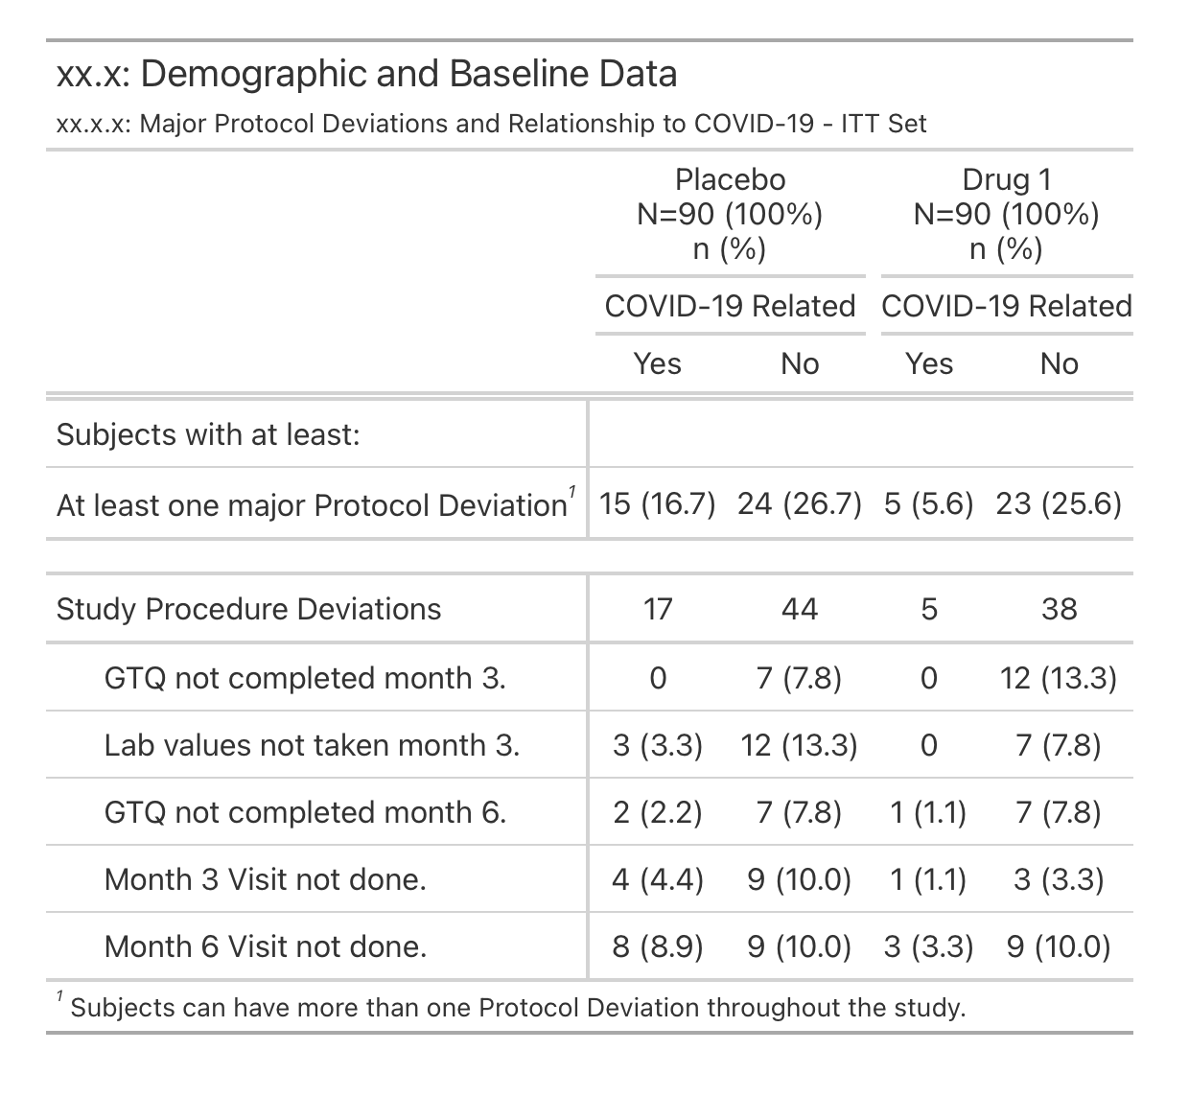
PAST
POSIT
GT
The gt package. Pretty good for Pharma tables.
With gt, you can now create tables like this one:
blastula
fontawesome
pointblank
bigD
HTML emails through R and Posit Connect
Easily insert icons in reports and Shiny apps
Ensure data correctness, make data docs
Advanced formatting of dates and times
More on this at:
https://gt.rstudio.com/articles/case-study-clinical-tables.html

Slide 28
PAST
POSIT
GT
Why we started work on gt.
knitr
Here’s all the packages we looked at in early 2018.
2011
kableExtra
2015
formattable
2015
DT
2014
pander
2012
huxtable
2017
flextable
2016
pixiedust
2015
tangram
2016
ztable
2014
condformat
2015
stargazer
2012
xtable
2000

Slide 29
PAST
POSIT
GT
Why we started work on gt.
knitr
Here’s all the packages we looked at in early 2018.
2011
kableExtra
2015
formattable
They had strengths in different areas, some were noted to be domain-specific while others were general.
2015
DT
2014
pander
2012
huxtable
Most handled one, maybe two, sometimes a few output formats.
2017
flextable
2016
pixiedust
2015
tangram
2016
ztable
2014
condformat
2015
stargazer
2012
xtable
2000

Slide 30
PAST
POSIT
GT
Why we started work on gt.
knitr
Here’s all the packages we looked at in early 2018.
2011
kableExtra
2015
formattable
They had strengths in different areas, some were noted to be domain-specific while others were general.
2015
DT
2014
pander
2012
huxtable
Most handled one, maybe two, sometimes a few output formats.
2017
flextable
2016
pixiedust
2015
tangram
2016
ztable
2014
We wanted to make something ggplot-like, focusing on non-interactive tables that deliver ready-to-use output (in different formats).
condformat
2015
stargazer
2012
xtable
2000

Slide 31
PAST
POSIT
GT
When we made gt public, we got much user feedback.
We publicly released gt in late 2018.
With it, you could make tables in HTML, LaTeX, and RTF.

Slide 32
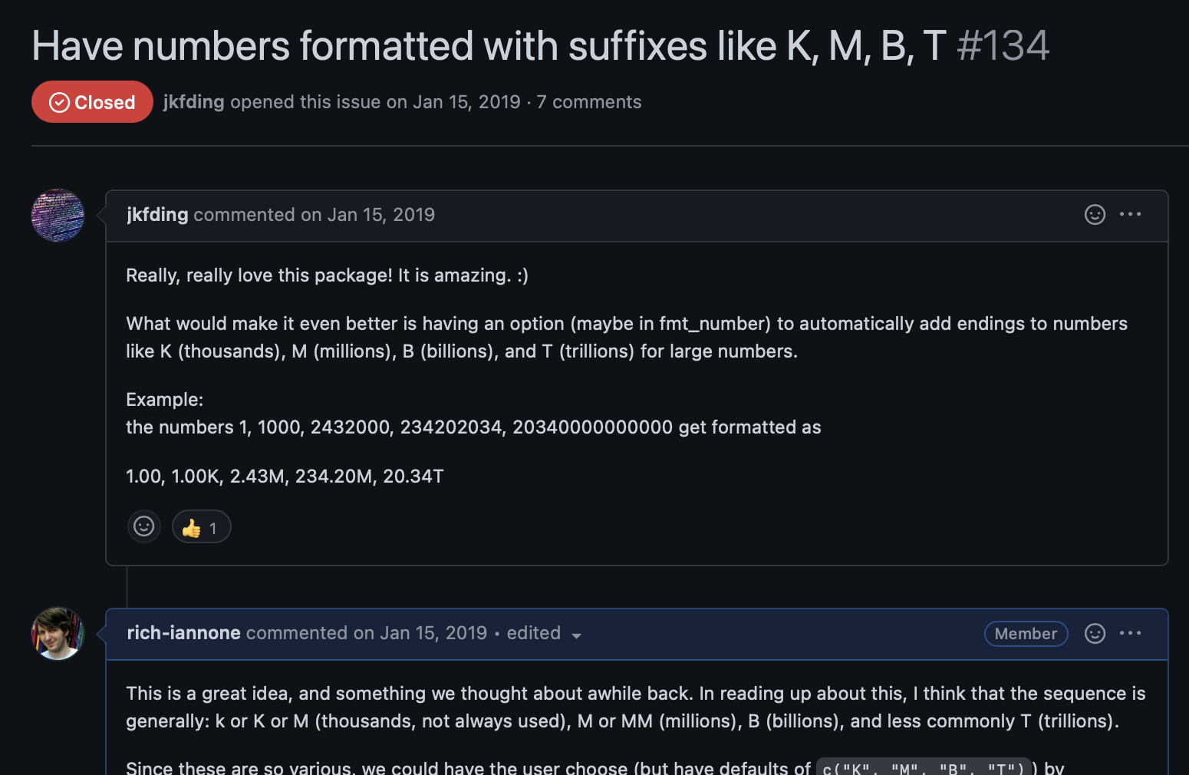
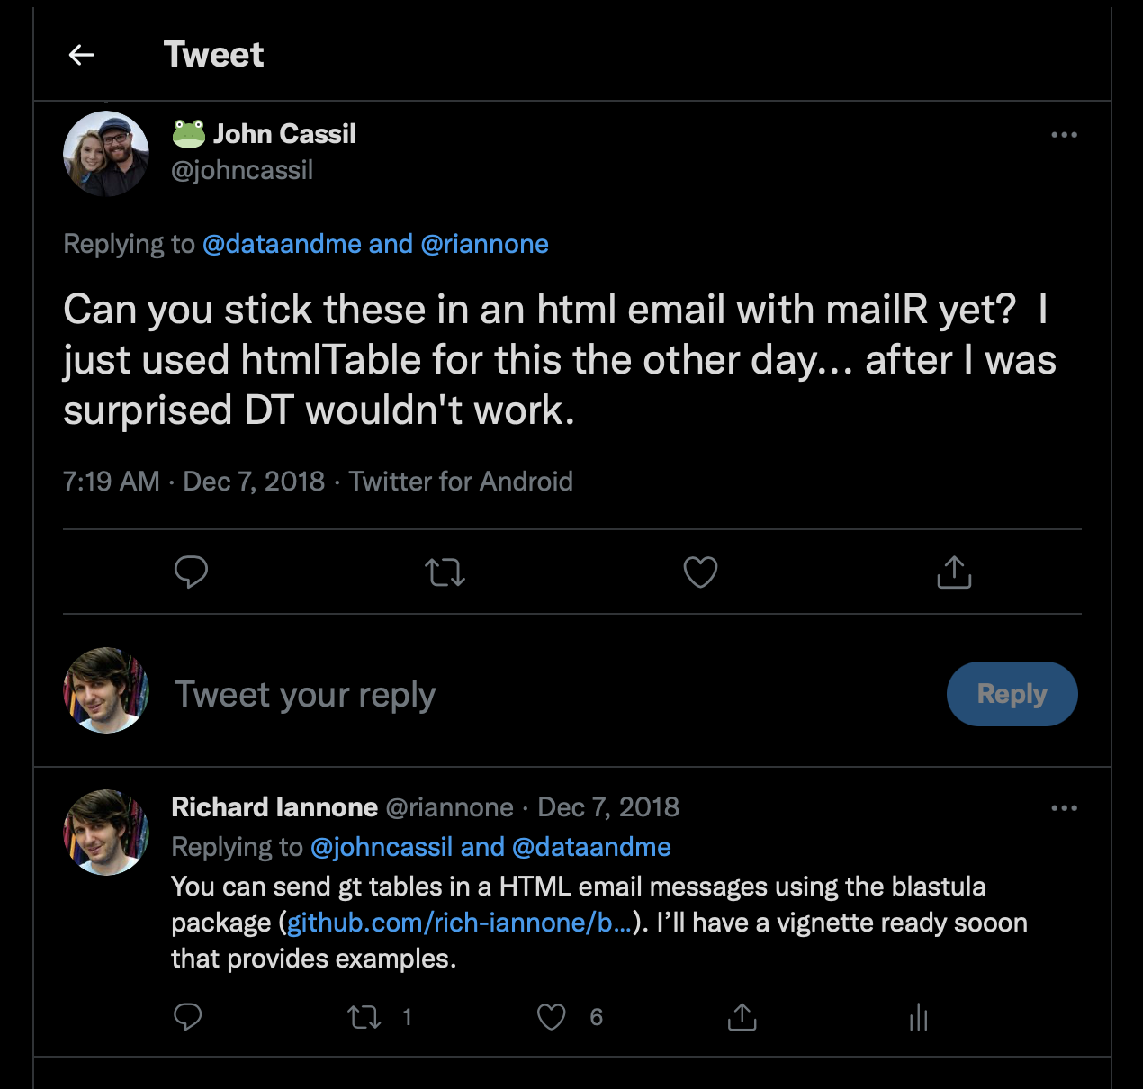
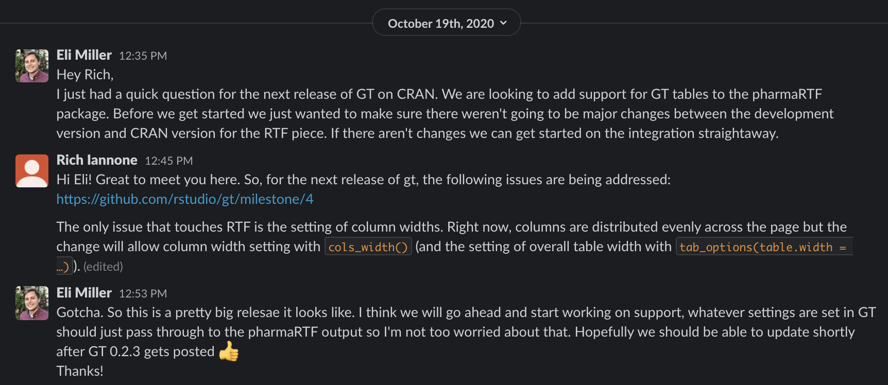
PAST
POSIT
GT
When we made gt public, we got much user feedback.
We publicly released gt in late 2018.
With it, you could make tables in HTML, LaTeX, and RTF.
Since then, we’ve had numerous discussions on social media,
in GitHub issues, and through customer conversations.

Slide 33
PAST
POSIT
GT
When we made gt public, we got much user feedback.
We publicly released gt in late 2018.
With it, you could make tables in HTML, LaTeX, and RTF.
Since then, we’ve had numerous discussions on social media,
in GitHub issues, and through customer conversations.
Through all of that, we learned very quickly what was successful. We also learned that was very interested in this package.
PHARMA

Slide 34


PAST
POSIT
GT
We made gt public and listened to our users.
We fixed a lot of the initial technical problems and learned through the first 1–2 years of public release what users wanted most.
Improved RTF output
Additional cell formatters
More ways to style cells
fmt_engineering()
data_color()
fmt_bytes()
cell_text()
fmt_integer()
cell_fill()
fmt_markdown()
cell_borders()
Improved LaTeX output
fmt_missing()
google_font()
Improvements to
table structuring
API enhancements
More!

Slide 35
PAST
POSIT
GT
PHARMA
We made gt better for Pharma after getting some feedback.
We learned that many Pharma users didn’t have their table requirements met by the early release of gt. So, we talked to them to better understand the problem.
WHO WE TALKED TO:
Merck: Yilong Zhang, Keaven Anderson, and Alexandra Lauer
Pfizer: Tom Tensfeldt and Mike K. Smith
Atorus Research: Mike Stackhouse and Eli Miller
GSK: Ellis Hughes and Christina Fillmore
Novartis: Pierre Wallet and Harvey Lieberman

Slide 36
PAST
POSIT
GT
PHARMA
Developing gt to fit the needs of Pharma. First major fix.
THE PHARMA RECOMMENDATION:
No good solutions for having explanatory text within columns of numbers.
OUR FIX:
Introduce a set of functions to make this possible.
Column 1
Column 2
Column 3
Column 4
Column 5
7.24
15.24
2.78
73.23
3.26
12.75
36.87
13.40
–
73.38
numeric values
43.28
–
15.24
2.12
8.36
63.90
21.34
43.70
75.87
47.55
—
61.93
26.00
41.06
35.93
true
true
false
true
false
primary
secondary
primary
unknown
primary
character values
false
true
true
NA
true
Heterogeneous columns

Slide 37
PAST
POSIT
GT
PHARMA
Developing gt to fit the needs of Pharma. Second major fix.
THE PHARMA RECOMMENDATION:
You ought to support multiple levels of column spanners. Our tables have them.
OUR FIX:
Enhance the function that adds spanners (and make it easy to use)
Column Spanner Over Top
level 2 spanner
level 1 spanners
Column Spanner 1
Column Spanner 2
Column 1
Column 2
Column 3
Column 4
Column 5
23.42
–
15.24
2.12
8.36
63.90
21.34
43.70
75.23
47.55
—
61.93
26.00
43.07
35.93
1.29
17.60
15.58
13.47
11.78
–28.02
–10.55
–5.23
–0.49
3.52
86.92
65.23
47.25
35.29
47.20
Multiple Spanner Levels

Slide 38
PAST
POSIT
GT
PHARMA
Developing gt to fit the needs of Pharma. Third major fix.
THE PHARMA RECOMMENDATION:
Have a way to make indentation work reliably for the row labels.
OUR FIX:
Add a function to specify indentation. Allow use of leading whitespace too.
Column 1
Column 2
Column 3
Column 4
Location 1
7.24
15.24
2.78
73.23
Alt 1
12.75
36.87
13.40
–
indents
Alt 2
43.28
–
15.24
2.12
Alt 3
63.90
21.34
43.70
75.87
Secondary
—
61.93
26.00
41.06
Alt 1
36.47
83.72
37.82
29.00
indents
Alt 2
2.63
5.21
9.92
4.87
Alt 3
4.03
5.29
5.21
5.83
Heterogeneous columns
Indentation Levels in the Table Stub

Slide 39
PAST
POSIT
GT
PHARMA
Developing gt to fit the needs of Pharma. Fourth major fix.
THE PHARMA RECOMMENDATION:
Our summary rows are usually at the top of a group, but, gt only puts them below.
OUR FIX:
Modify summary row generation functions to provide a placement choice.
Column 1
Column 2
Column 3
Column 4
Group 1
7.24
15.24
2.78
73.23
Summary 1
12.75
36.87
13.40
25.13
summary rows
Summary 2
43.28
23.12
15.24
2.12
Summary 3
63.90
21.34
43.70
75.87
Row 1
8.23
1.93
6.10
3.06
Row 2
6.47
3.72
7.82
9.00
rows of ‘Group 1’
Row 3
2.63
5.21
9.92
4.87
Row 4
4.03
5.29
5.21
5.83
Heterogeneous columns
Summary Rows at Top of Group

Slide 40
PAST
POSIT
GT
PHARMA
Developing gt to fit the needs of Pharma. Fifth major fix.
THE PHARMA RECOMMENDATION:
Merging column values together doesn’t take into account missing values.
OUR FIX:
Add syntax in gt to deal with missing values in combining patterns.
Column 1
Column 2
Column 3
Column Combined
Row 1
3
1.12
2.78
3 (1.12, 2.78)
Row 2
2
3.25
—
2 (3.25)
Row 3
7
—
3.87
7
Row 4
10
5.34
3.70
10 (5.34, 3.70)
combined
values
Row 5
—
2.93
6.00
—
Row 6
3
8.12
6.18
3 (8.12, 6.18)
Row 7
2
5.21
—
2 (5.21)
Row 8
8
5.29
1.34
8 (5.29, 1.34)
Heterogeneous columns
Better handling of NA values when merging adjacent cells

Slide 41
PAST
POSIT
GT
PHARMA
Also, gt is being developed by individuals in Pharma!
Some Pharma users have joined us by putting on their developer hats, contributing large amounts of code to gt.
WHO ARE THEY AND WHAT HAVE THEY DONE?
Merck: Alexandra Lauer
Generated new datasets for the package. Wrote articles that use the datasets to demonstrate Pharma applications for package.
https://gt.rstudio.com/articles/case-study-clinical-tables.html
https://gt.rstudio.com/reference/rx_adsl.html
https://gt.rstudio.com/reference/rx_addv.html
GSK: Ellis Hughes
Wrote 1000s of lines of code for the Word output feature. Without that work, Word tables from gt wouldn’t be as good as they are now.
Heterogeneous columns

Slide 42

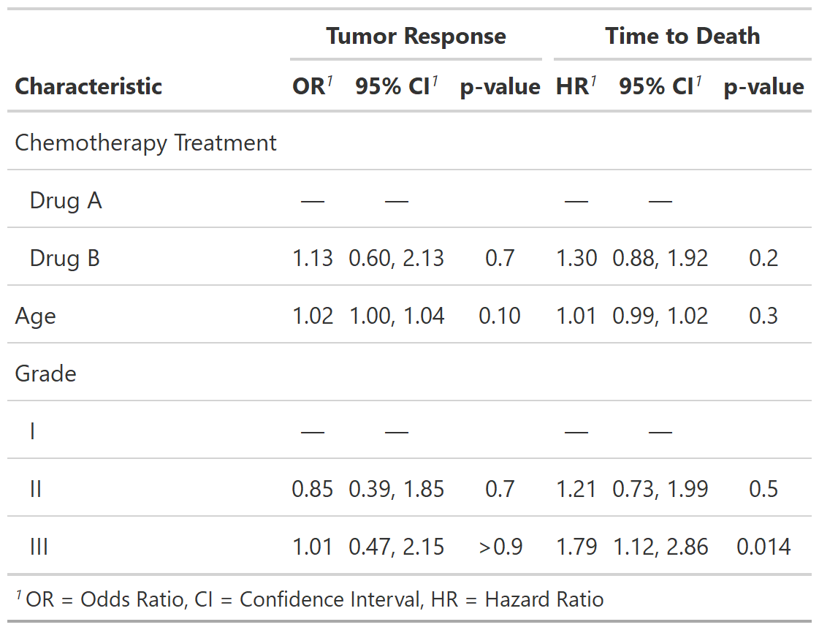
PAST
POSIT
GT
PHARMA
Pharma-built extensions of gt: gtsummary
F
F
The gtsummary package was built by
Daniel Sjoberg
of
Roche
It’s very useful for most
PHARMA
applications and is widely used.
gtsummary

Slide 43

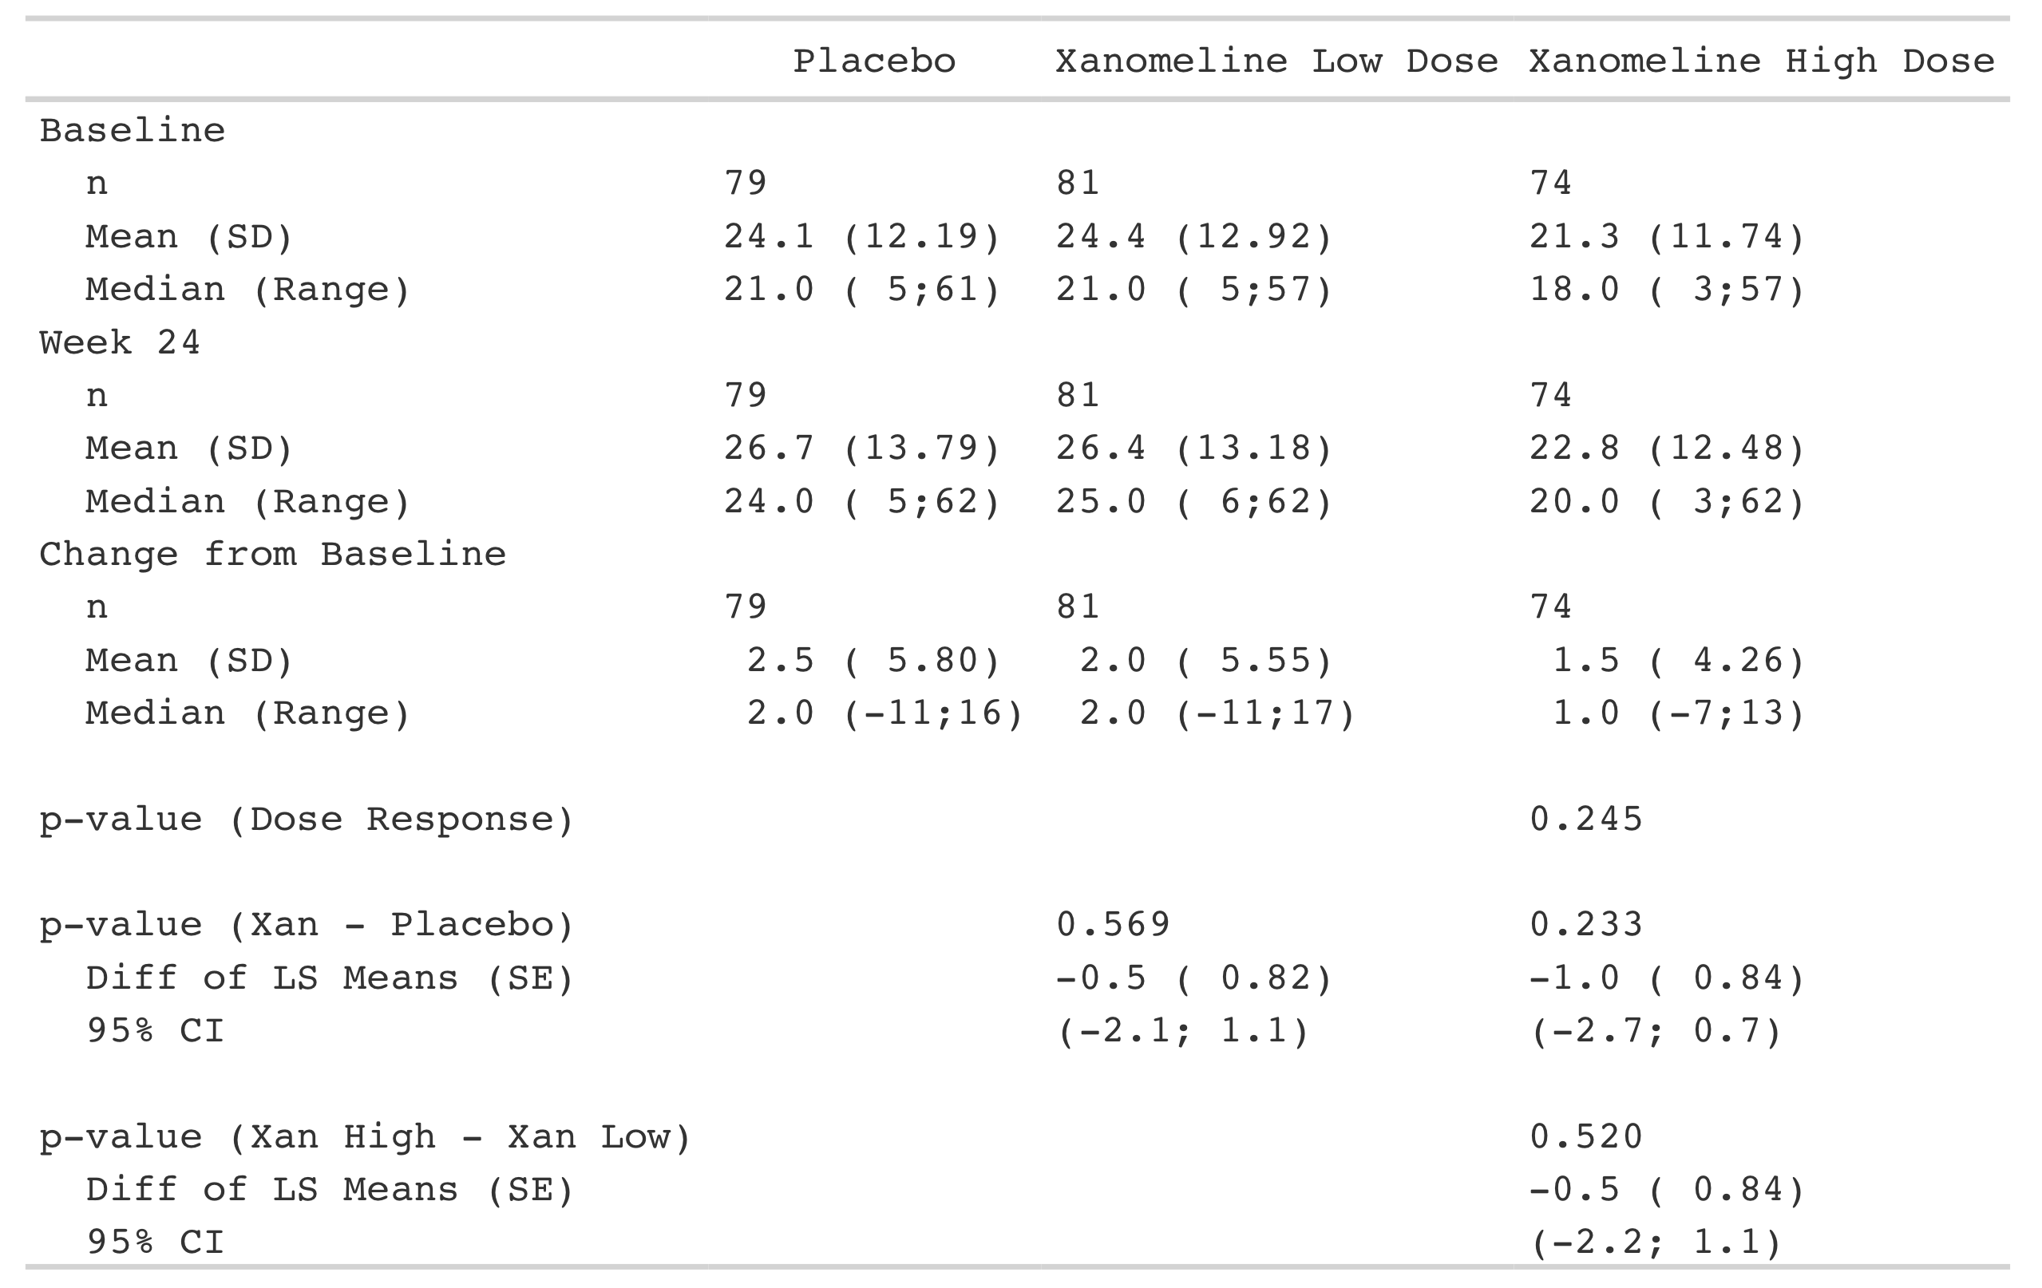
PAST
POSIT
GT
PHARMA
Pharma-built extensions of gt: tfrmt
F
F
The tfrmt package was built by
Christina Fillmore
of
GSK
Again, extremely useful for
PHARMA
tables (especially those for submissions)
tfrmt

Slide 44


PAST
POSIT
GT
PHARMA
Pharma-built extensions of gt: gto
F
F
The gto package was built by
Ellis Hughes
of
GSK
And, as I understand it, those in
PHARMA
have a need to put tables in Word docs.
gto

Slide 45
PRESENT
POSIT
GT
It seems that people have been using gt quite a lot.
We are seeing evidence of a fairly large and enthusiastic user base.
Here are some of the metrics that show signs of success:
Highly mentioned R pkgs on Twitter
GitHub stars
Closed GitHub issues
tidyverse
1.8k⭐️
600+
tensorflow
ggplot2
shiny
Presentations given
Known pharmas using gt
12
8
gt
Mentions since 2010
20k
40k
60k

Slide 46
PRESENT
POSIT
GT
Users across industry and academia have been using gt quite a lot.
Highly mentioned R pkgs on Twitter
GitHub stars
Closed GitHub issues
tidyverse
1.8k⭐️
600+
tensorflow
ggplot2
shiny
Presentations given
Known pharmas using gt
12
8
gt
Mentions since 2010
20k
40k
60k
Being successful with gt is pretty important. It means we can continue to invest a large amount of developer effort into this package and its related projects.

Slide 47
PRESENT
POSIT
GT
Ensuring software quality for gt and work to reduce user risk
We want to make sure you could trust the software so, as we often do, many software quality practices were adopted for gt.

Slide 48
PRESENT
POSIT
GT
Ensuring software quality for gt and work to reduce user risk
We want to make sure you could trust the software so, as we often do, many software quality practices were adopted for gt.
MUCH TESTING:
— there are 7,500 unit tests for gt! While a lot, that's not nearly enough.

Slide 49


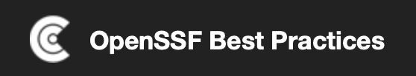
PRESENT
POSIT
GT
Ensuring software quality for gt and work to reduce user risk
We want to make sure you could trust the software so, as we often do, many software quality practices were adopted for gt.
MUCH TESTING:
— there are 7,500 unit tests for gt! While a lot, that's not nearly enough.
EXTERNAL CERTIFICATION:
— we have certified gt against the Linux Foundation's OpenSSF Best Practices initiative. We got the gold level status:
More on this at:
https://www.bestpractices.dev/en/projects/5593

Slide 50

PAST
PRESENT
FUTURE
PHARMA
The R-Consortium R Tables Working Group: RTRS-WG.
To get more dialogue going about what Pharma needs in terms of tables, a working group was started to discuss that.
RTRS // R Tables for Regulatory Submissions Working Group
“Creating standards to guide the development of R tools for creating tables that meet the requirements of the FDA and other regulatory agencies”
We meet every six weeks via Zoom to discuss and plan improvements to the R table ecosystem for benefit of Pharma.
All are welcome to join!
Heterogeneous columns

Slide 51
PAST
PRESENT
FUTURE
PHARMA
The R-Consortium R Tables Working Group: RTRS-WG.
We identify needs, try to find common ground, and propose actual work that will someday make the arduous and costly task of generating tables easier.
RTRS // R Tables for Regulatory Submissions Working Group
Joseph Rickert, the Executive Director of the R Consortium, organizes and leads these meetings.
If your role involves table generation and regulatory submissions for the Pharma industry, then you might want to join these meetings.
If you do, you’ll learn what your peers and doing, what they need, and what will be developed insofar as table-generation R packages is concerned.
Heterogeneous columns

Slide 52
PAST
PRESENT
FUTURE
PHARMA
The R-Consortium R Tables Working Group: RTRS-WG.
WHAT WE’VE BEEN WORKING ON
— creating a book called Tables in Clinical Trials with R
— developing archetypes for table generation to use in our R packages
— creating blog posts and promoting the working group
RTRS // R Tables for Regulatory Submissions Working Group
“Creating standards to guide the development of R tools for creating tables that meet the requirements of the FDA and other regulatory agencies”
Meets every six weeks via Zoom to discuss and plan improvements to the R table ecosystem for benefit of Pharma. All are welcome to join.
CONTACT
Joseph Rickert
Executive Director, R Consortium
director@r-consortium.org
Heterogeneous columns

Slide 53
PAST
PRESENT
FUTURE
PHARMA
The R-Consortium R Tables Working Group: RTRS-WG.
RTRS // R Tables for Regulatory Submissions Working Group
“Creating standards to guide the development of R tools for creating tables that meet the requirements of the FDA and other regulatory agencies”
Meets every six weeks via Zoom to discuss and plan improvements to the R table ecosystem for benefit of Pharma. All are welcome to join.
CONTACT
Joseph Rickert
Executive Director, R Consortium
director@r-consortium.org
If you are interested in collaborating with us, please contact Joseph Rickert by email at:
director@r-consortium.org
He’ll then send you Zoom meeting invites for the meetings.
Heterogeneous columns

Slide 54
PAST
PRESENT
FUTURE
PHARMA
The R-Consortium pilot projects with the FDA.
THE R SUBMISSIONS WORKING GROUP HAS HAD GREAT SUCCESS
— recently sent the third R-based test submission through the FDA eCTD gateway (August 28, 2023)
Heterogeneous columns
More on this at:
https://rconsortium.github.io/submissions-wg/

Slide 55
PAST
PRESENT
FUTURE
PHARMA
The R-Consortium pilot projects with the FDA.
THE R SUBMISSIONS WORKING GROUP HAS HAD GREAT SUCCESS
— recently sent the third R-based test submission through the FDA eCTD gateway (August 28, 2023)
— this is the first publicly available R-based FDA submission package, which includes R scripts to generate ADaM datasets and TLFs
Heterogeneous columns
More on this at:
https://rconsortium.github.io/submissions-wg/

Slide 56
PAST
PRESENT
FUTURE
PHARMA
The R-Consortium pilot projects with the FDA.
THE R SUBMISSIONS WORKING GROUP HAS HAD GREAT SUCCESS
— recently sent the third R-based test submission through the FDA eCTD gateway (August 28, 2023)
— this is the first publicly available R-based FDA submission package, which includes R scripts to generate ADaM datasets and TLFs
— all of this is very promising and further shows that R and open-source packages can provide an end-to-end solution for Pharma submissions
Heterogeneous columns
More on this at:
https://rconsortium.github.io/submissions-wg/

Slide 57
FUTURE
POSIT
GT
Getting back to gt, the future looks bright and it involves you.
We’d like the gt package to remain successful. And you have a large influence on its future development. At least eight Pharmas are using the package.

Slide 58
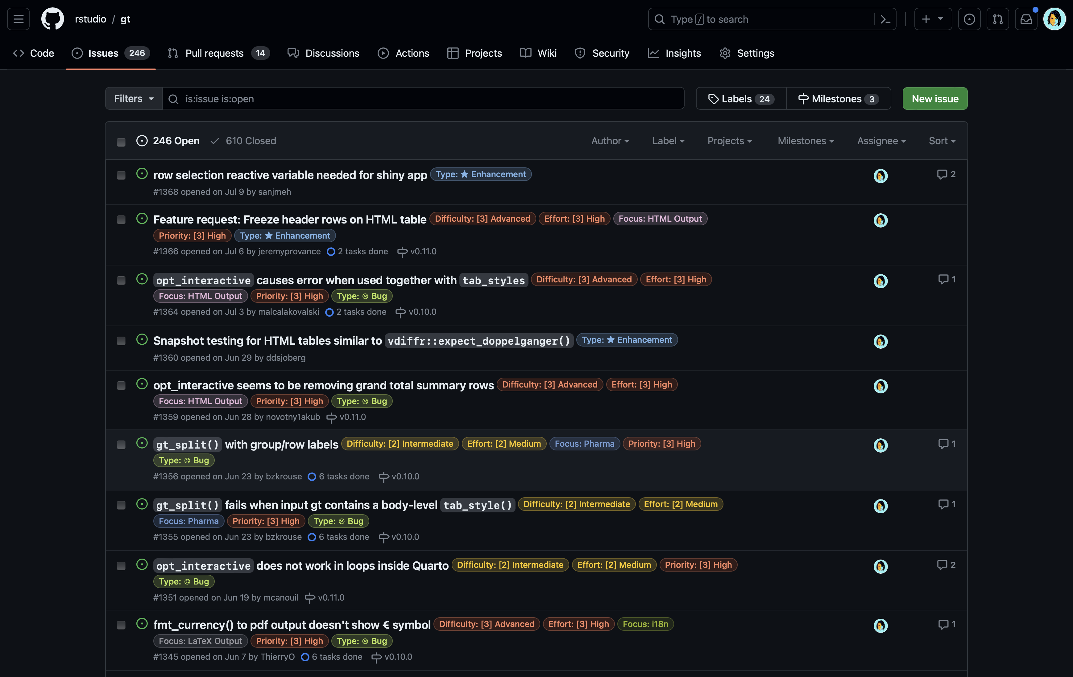
FUTURE
POSIT
GT
Getting back to gt, the future looks bright and it involves you.
We’d like the gt package to remain successful. And you have a large influence on its future development. At least eight Pharmas are using the package.
Use the package and tell us ways it could work better for your needs.
— submit general comments or feature requests
— tell us about a problem you encountered with the package

Slide 59
FUTURE
POSIT
GT
Getting back to gt, the future looks bright and it involves you.
We’d like the gt package to remain successful. And you have a large influence on its future development. At least eight Pharmas are using the package.
Create a package that uses gt in some way (maybe tables are the output).
— some packages are using gt, you could also make your own
— idea: new package could simply generate analysis tables rendered with gt
— idea: could make new functions (e.g., cell formatting) that work with gt
— idea: how about a new output format for tables created with gt?
— idea: new Pharma-focused R package based on gt with enhanced tooling

Slide 60
FUTURE
POSIT
GT
Getting back to gt, the future looks bright and it involves you.
We’d like the gt package to remain successful. And you have a large influence on its future development. At least eight Pharmas are using the package.
Demonstrate how the gt package can be used
— write articles for your own blog, a company blog, or a different website
— create a GH repository full of useful examples
— write a technical book or long-form technical documentation
— teach others in workshop settings

Slide 61
Open Call for
Open Source
Collaboration
It's better to work together so please reach out to me for
anything and everything I could help with.
EXAMPLES package improvements, training, new projects
Thank you!
rich-iannone
rich@posit.co

Slide 62
https://github.com/rich-iannone/presentations
rich-iannone
rich@posit.co

Slide 63
PAST
PRESENT
FUTURE
PHARMA
Working with Pharma in the R Tables Working Group: RTRS-WG.
RTRS // R Tables for Regulatory Submissions Working Group
THOSE WHO HAVE ATTENDED:
Merck: Yilong Zhang, Arthur Allignol, Keaven Anderson, Alexandra Lauer
Pfizer: Tom Tensfeldt, Mike K. Smith, James Kim
Atorus Research: Mike Stackhouse, Eli Miller, Nathan Kosiba
Roche: Adrian Waddell, Gabe Becker, Ning Leng, Daniel Sjoberg, Tad Lewandowski
GSK: Ellis Hughes, Christina Fillmore, Michael Rimler, Ben Straub
JnJ: Steven Hassendonckx, Paulo Bargo, Tadeusz Lewandowski, Nicholas Masel, Sheng-Wei Wang
Biogen: Himanshu Pandya, Bob Engle
Eli Lilly: Samir Parmar
Novo Nordisk: Søren Klim
Novartis: Pierre Wallet
Yale: Michael Kane
ArData: David Gohel
Posit: Richard Iannone, Joe Cheng, Phil Bowsher
FDA: Bryant Chen
Heterogeneous columns

